Slide 1
SMART GARAGE
Submitted in the partial fulfillment for the award of the degree of
BACHELOR OF ENGINEERING
IN
COMPUTER SCIENCE AND ENGINEERING
(Internet of Things)
Submitted by:
PARIKSHIT SHARMA(19BCS4520)
SARABJIT KAUR(19BCS4536)
S.V.N RAHUL(19BCS4539)
RITIKA (19BCS4540)
Under the Supervision of:
Dr. MONICA LUTHRA
Department of AIT-CSE
DISCOVER . LEARN . EMPOWER

Slide 2
Outline
Introduction to Project
Problem Formulation
Objectives of the work
Methodology used
Results and Outputs
Conclusion
Future Scope
References

Slide 3
Introduction to Project
Due to the current scenario of Covid-19 so as part of our contribution that is preventing the physical touch. This project is being automatic. So as to prevent physical touch we can apply this Smart garage into a real-life Application as its low cost, more efficient, easy access at low complexity.
With the fast-growing world with many inventions and innovations are being made . Making the more complex things into a simpler form by using sensors . With or without our knowledge many things are being automated. As many things are being invented, innovations are being done. As a part of innovation, we are doing this project which is a part of our course i.e IoT. Sensors are one of the important sources which are used for automation. Smart Garage is one such innovation that will make the life of the user easy and secure, automated. It will also ensure the safety of the garage by sending SMS alerts when it connected to the wifi or cloud.

Slide 4
Open and close the garage using Motion or Vehicle detection, detects with and also equipped with a buzzer to ensure that the vehicle is being parked in the garage and the buzzer gives a sound when the garage door is closing.
It can be developed in such a way that fully Internet-based in case it is connected with a device like NodeMCU, or ESP32, ESP8266 to get an SMS alert message and a list of the user details like phone number, time, date IP address, location, and device status using Whatsapp chatbox. This project helps to reduce the burden of the owner to open the sliding door manually .
It will open automatically when you give a motion or when the vehicle is in front of the garage and closes automatically if the car is parked. The main advantage of this innovation is reducing human effort, time, security, automation.

Slide 5
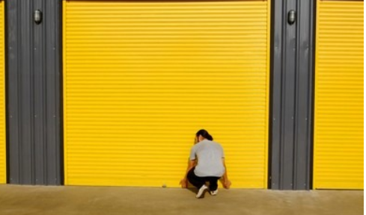
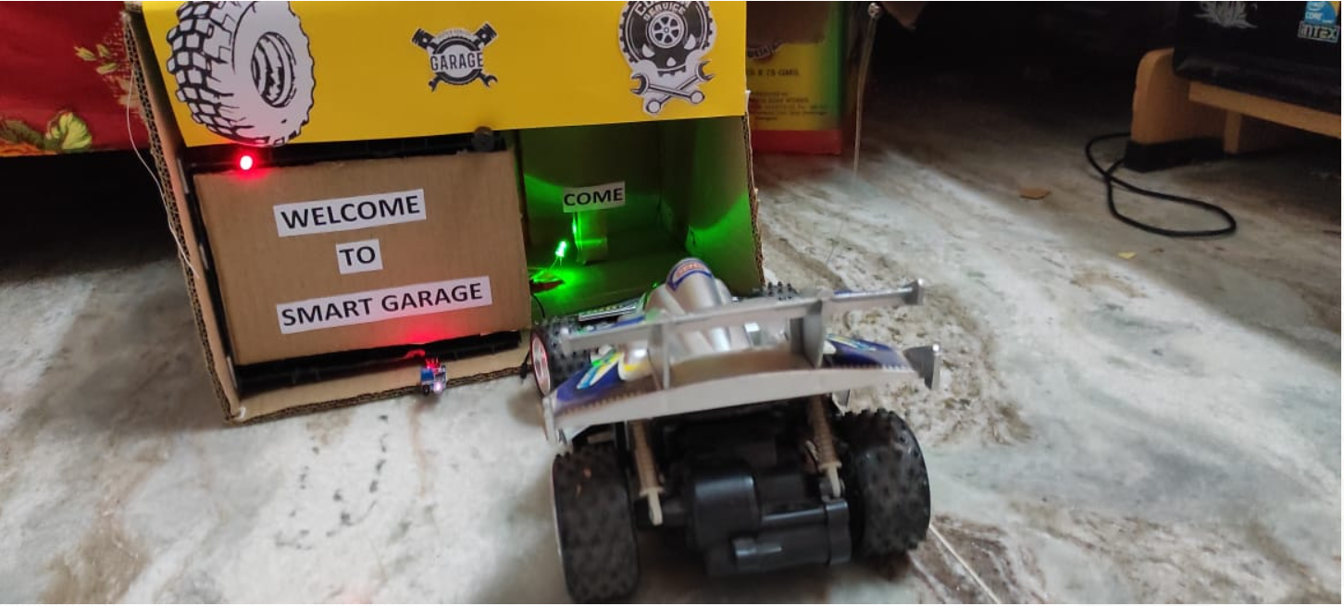
Problem Formulation
Case 1:The main problem is arising when you need to park or remove the vehicle you need to put some physical effort and you need to use physical touch.
SO if we use this proposed project you can park or remove the car whenever you need it without any physical effort or touch and thus prevent it from being attacked by COVID Virus.

Slide 6
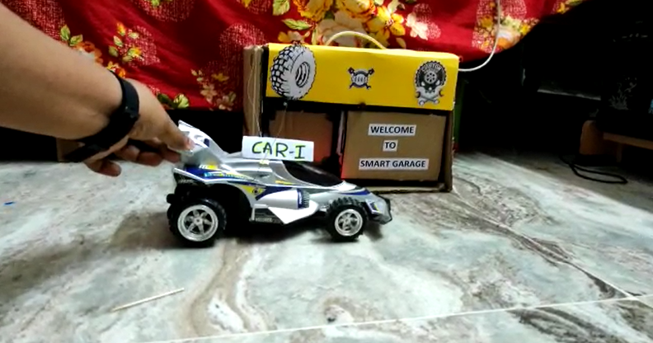
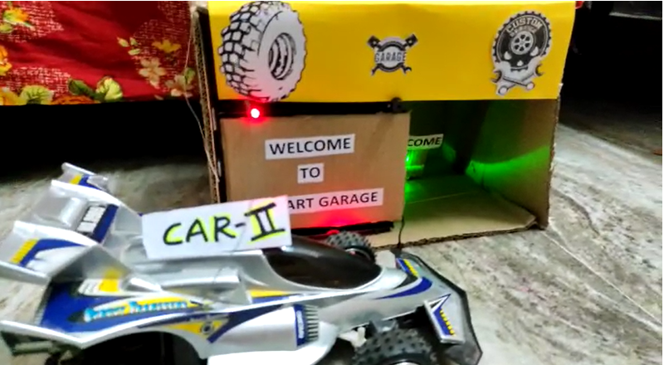
Case-2: Two Vehicles come simultaneously one is in the garage and the other should be outside. At the same time vehicle 2 has arrived at the garage vehicle 1 is being parked so if two cars at the same time go in there may be an accident for the vehicles this may lead to some damage so in order to prevent that situation that the concept of Smart systematic lighting is being used Vehicle 2 recognize the red light and buzzer sound, wait until the Vehicle1 is being parked and then park the vehicle 2 accordingly.

Slide 7
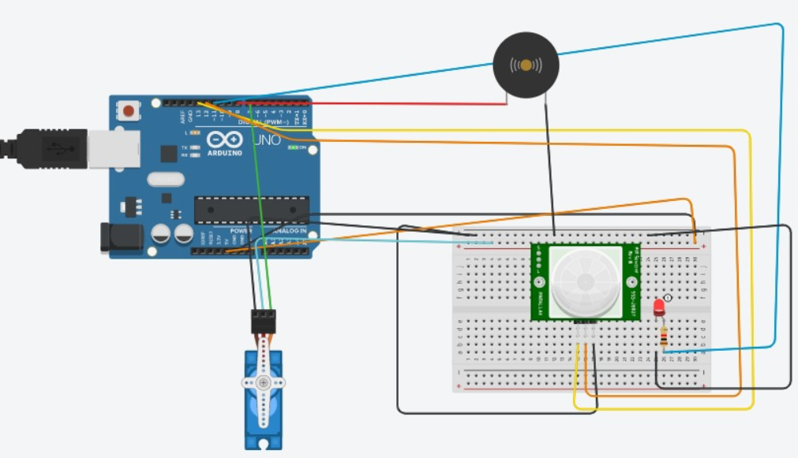
Objectives
Virtual stimulation using Tinker Cad software and all the connections and code should work perfectly.
Link TinkerCad Stimulation:
https://drive.google.com/drive/folders/1Co3mKJwZI3SvVHLU_---sYZzGRVKua3Y?usp=sharing

Slide 8
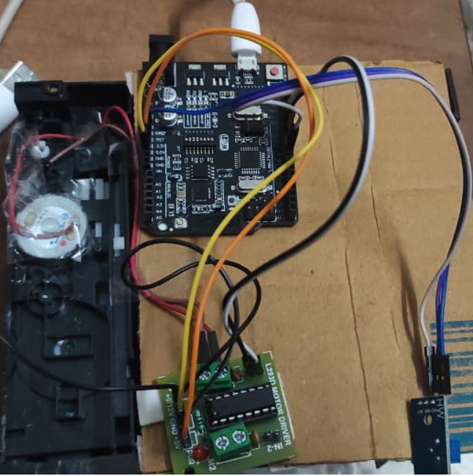
2.Hardware assembling and connections ,Arduino code without any errors.
Video Link: Hardware stimulation: - Google Drive
https://drive.google.com/drive/folders/19RpQTaqnTLzCoxQynsF8NnvPK4XjMKaV?usp=sharing
The above pictures describe the hardware connections and the model of the smart garage and its working.

Slide 9
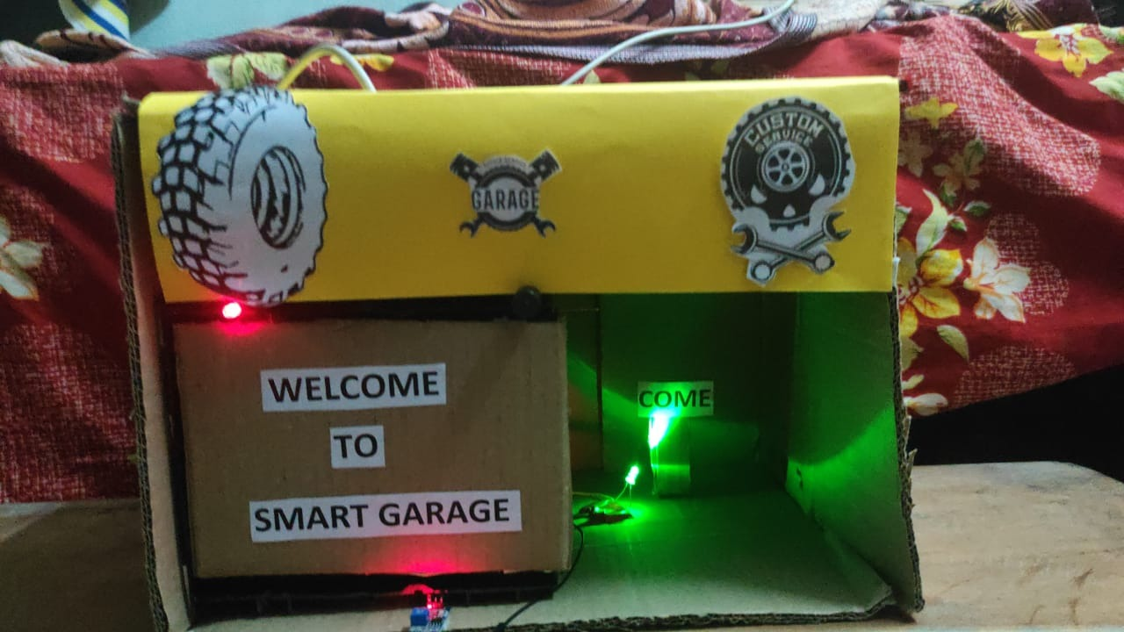
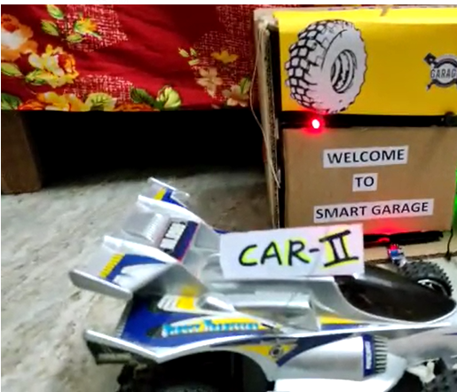
3.The smart systematic lighting concept is one of the unique features of our project that helps garage and vehicle safety. This actually works with Two lights one is red and another one is green, As we all know that green is used for going and red is used for stopping as a part of traffic lights. So the same is concept is being applied hereThe images indicates the smart systematic system and car 2 is following the process.

Slide 10
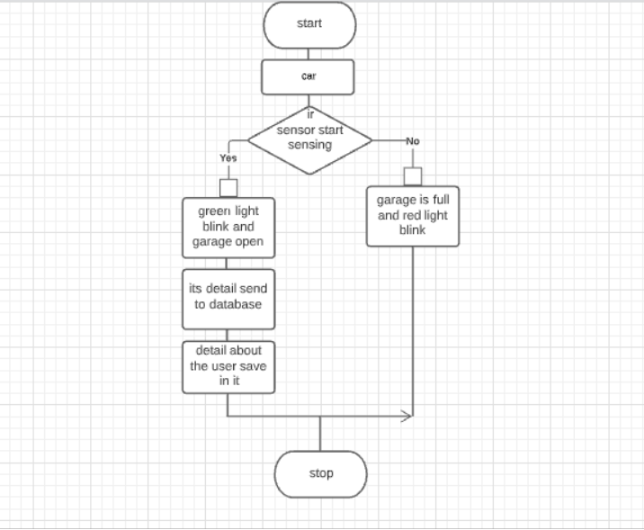
Methodology used

Slide 11
Step-1: Start
Step-2: The vehicle is approaching the Garage.
Step-3: Ir sensor start sensing the vehicle and if yes the garage door is opened, and Buzzer gives a sound outside and Redlight also blinks outside the garage, Greenlight blinks inside the garage,
Step-4: After sensing the vehicle door open and wait till the vehicle is parked and remains all in the off state, the Garage door closes accordingly.
Step-5:If it's connected to Wifi or cloud the garage status can be checked by using Whatsapp Api by giving its id, You can check the status of the garage in the Twilio software I,.e the name, contact details of the garage accessed, IP address, Date and time, And the location of the place from where the garage has been accessed.
Step-6: If no the garage remains as it is that is closed.
Step -7:Stop.

Slide 12
Results and Outputs
Video:
Hardware:
https://drive.google.com/drive/folders/19RpQTaqnTLzCoxQynsF8NnvPK4XjMKaV?usp=sharing
Tinkercad stimulation:
https://drive.google.com/drive/folders/1Co3mKJwZI3SvVHLU_---sYZzGRVKua3Y?usp=sharing
Link for Twilio video stimulation:
https://drive.google.com/drive/folders/1R6--HmghKBWTM-taybng4zJeUo63Bprp?usp=sharing

Slide 13
Link for Google assistant connected by IFTTT(Stimulation)
https://drive.google.com/drive/folders/1kzgAZtn7fahrOeusAW5ZwpBbZm4e2b6p?usp=sharing
Website:
https://saraburahul19.wixsite.com/my-site-1

Slide 14
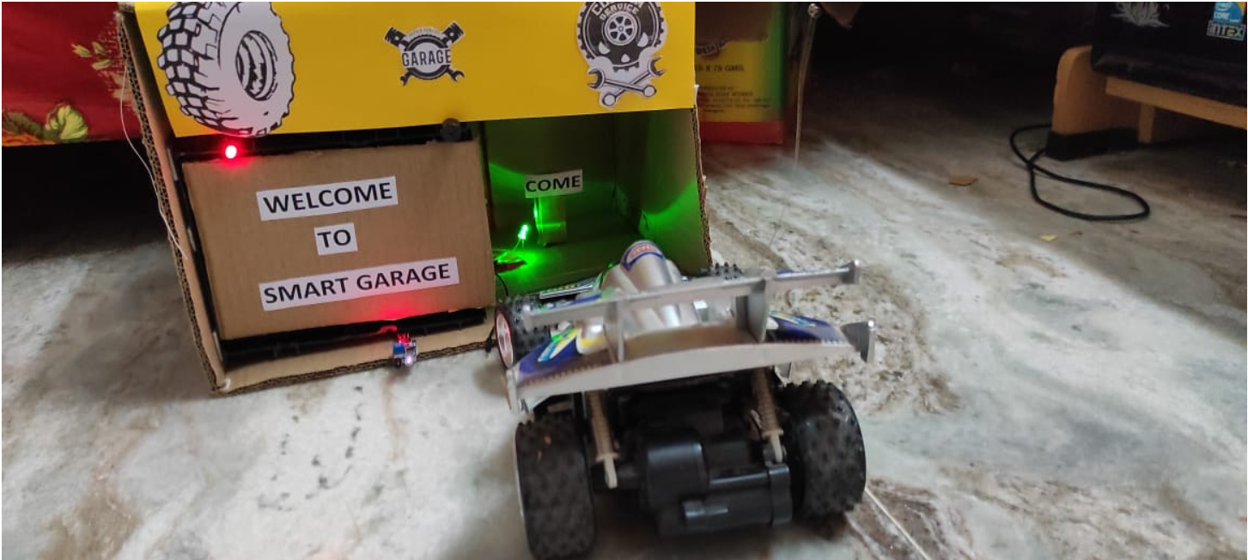
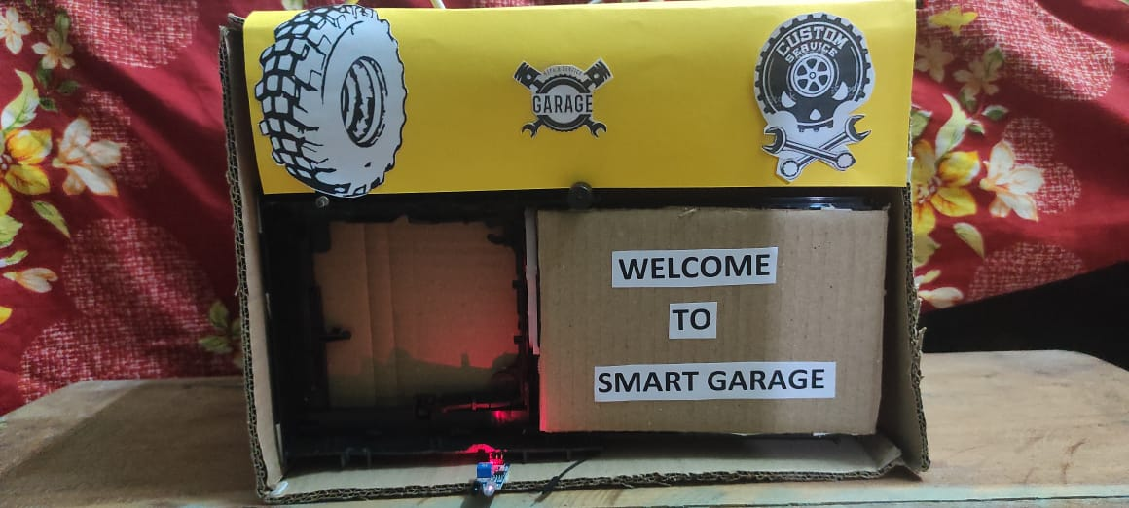
PROTOTYPE
CLOSE
OPEN

Slide 15
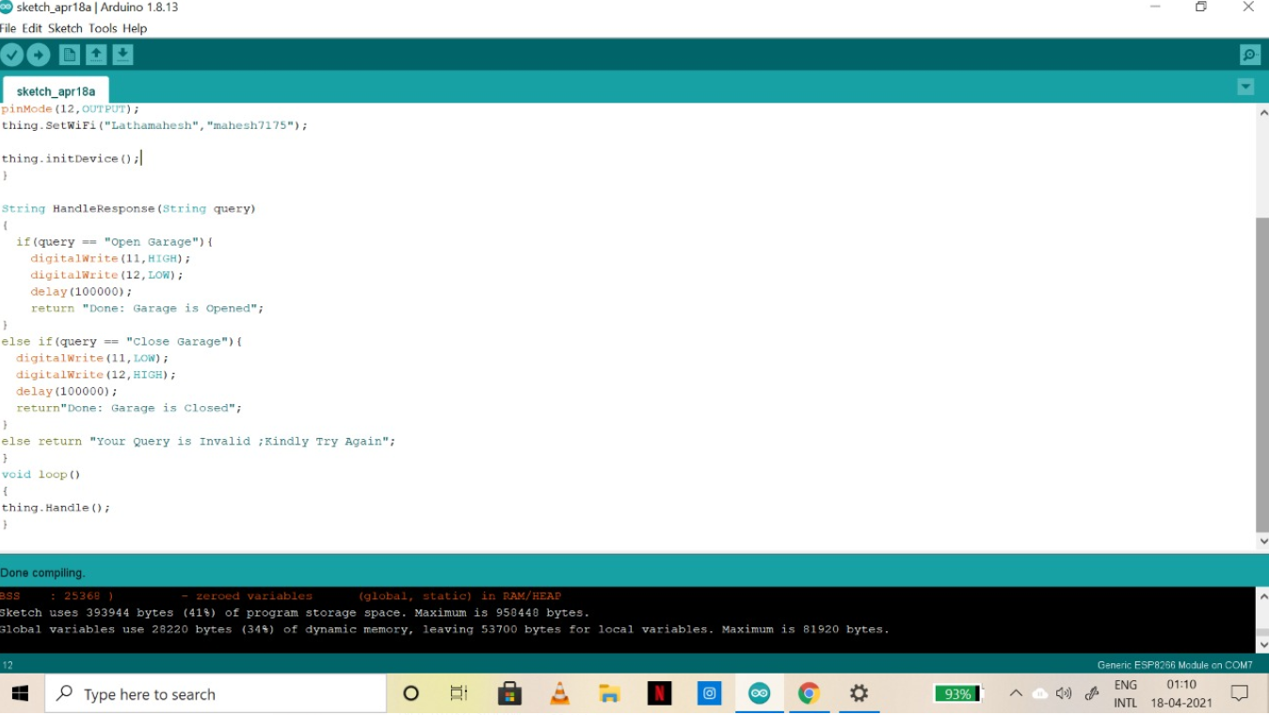
TINKERCAD
STIMULATION IMAGE
CODE

Slide 16
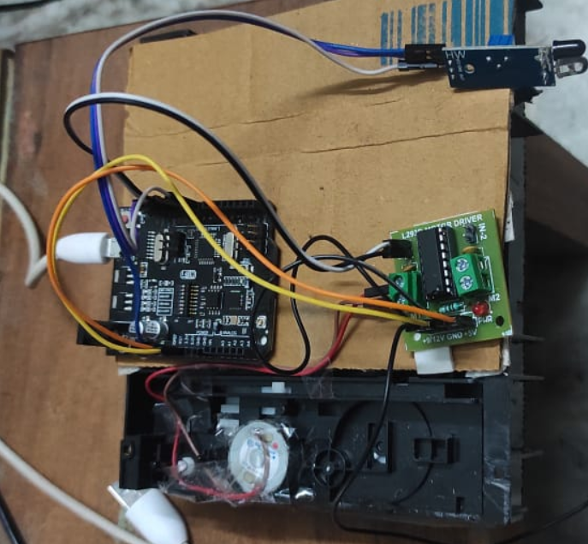
CONNECTIONS

Slide 17
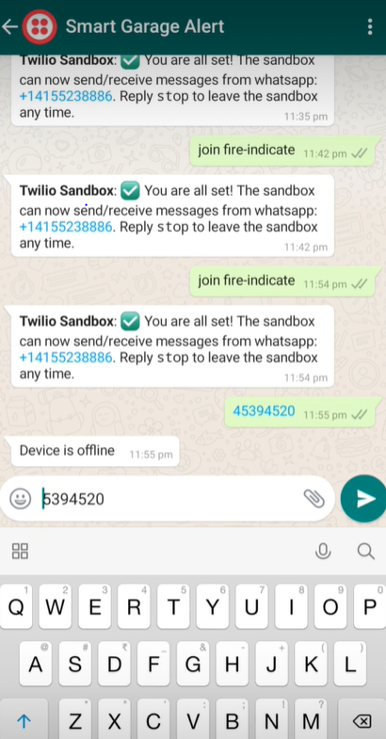
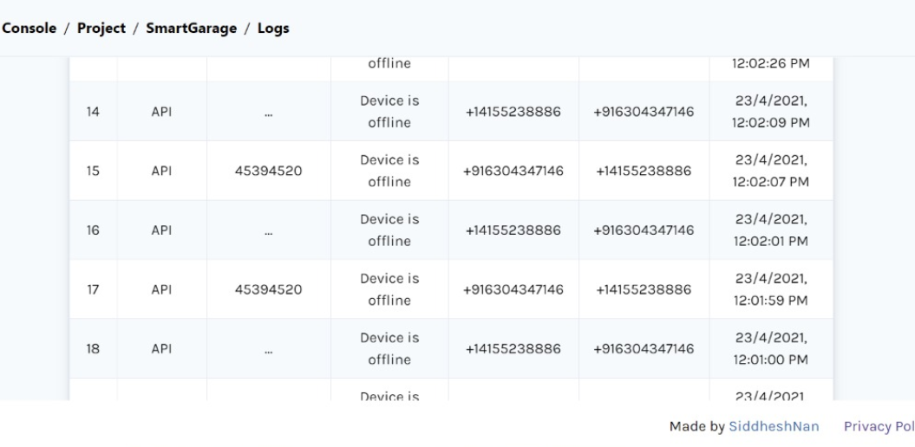
TWILIO-(WHATSAPP ALERT ,DATABASE)

Slide 18
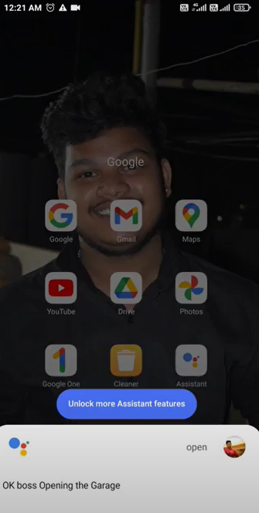
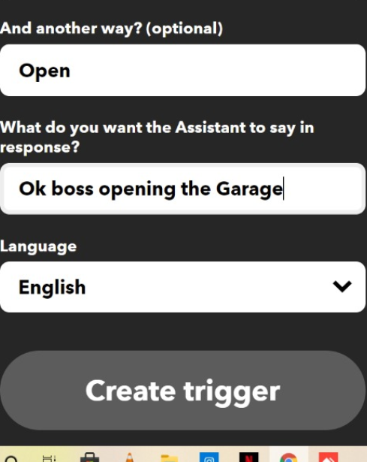
IFTTT(Google Assistant )

Slide 19
Conclusion
In conclusion, this project can be used at all places starting from domestic to industrial sectors. The simplicity in the usage of this circuit helps it to be used by a large number of people as people with less knowledge of hardware can also use it without facing any problem. The automatic smart garage will save us some time and increase the security of the vehicle . This project is more effective, cheap cost, improved technology, ease of access, affordable by everyone. This project can be improved to the next level by connecting the prototype to Wifi or cloud and can be made more secure, Access from anywhere in the world and we can also know the database and list of users, time of being accessed, contact details, IP address, date and time.

Slide 20
Future Scope
This project can be modified to the next level by upgrading the prototype to WiFi or any module like Node MCU, Esp32, ESP8266, or a hybrid board. The benefits of being connected with Wifi or Cloud areas follows :
1.It can be controlled from any part of the world.
2.It can be controlled through google assistant avoiding physical touch or human effort.
3.Due to the current scenario of spreading the Corona Virus this is a proposed and affordable solution to prevent the physical touch and helps to prevent the virus.
4.One of the unique features of this project being connected with WiFi is that to ensure security by specific voice recognization that no third-party user cannot access the garage even though if he is having google assistant in case if he tries to open then through Twilio system we receive a message that unauthorized user is trying to access the garage thus can produce an alarm to prevent from theft.

Slide 21
References
1. สอนใช้งาน Arduino UNO+WiFi R3 ATmega328P+ESP8266 Web Server Wifi - YouTube
2. Send WhatsApp Messages to ESP32, ESP8266 & NodeMCU using Twilio API and ThingESP - YouTube
3. How to make Automatic Sliding Door/ Easy Tutorial - YouTube
4.https://thingesp.siddhesh.me/#/console/home
5. https://www.twilio.com/
6. https://ifttt.com/home

